Slide 1

Understanding YouTube Trends in France
The dataset contains 40,725 rows of trending YouTube videos in France.
We analyzed metrics like views, likes, dislikes, comment counts, and categories.
The goal was to understand what makes a video trend, how long they stay trending, and which categories perform best.
"The French YouTube landscape seemed diverse, with a wide variety of content types and engagement patterns."

Slide 2
Patterns, Anomalies & Questions
This is where we point out findings or surprises:
1
Category Imbalance
A few categories dominated trending content — like Entertainment, Music, and News & Politics.
Some categories like Science & Tech or How-to & Style rarely trended.
Story Angle:
"While YouTube offers a platform for diverse content, we found that French viewers mostly engaged with entertainment-heavy genres — raising questions about discoverability and content diversity."

Slide 3
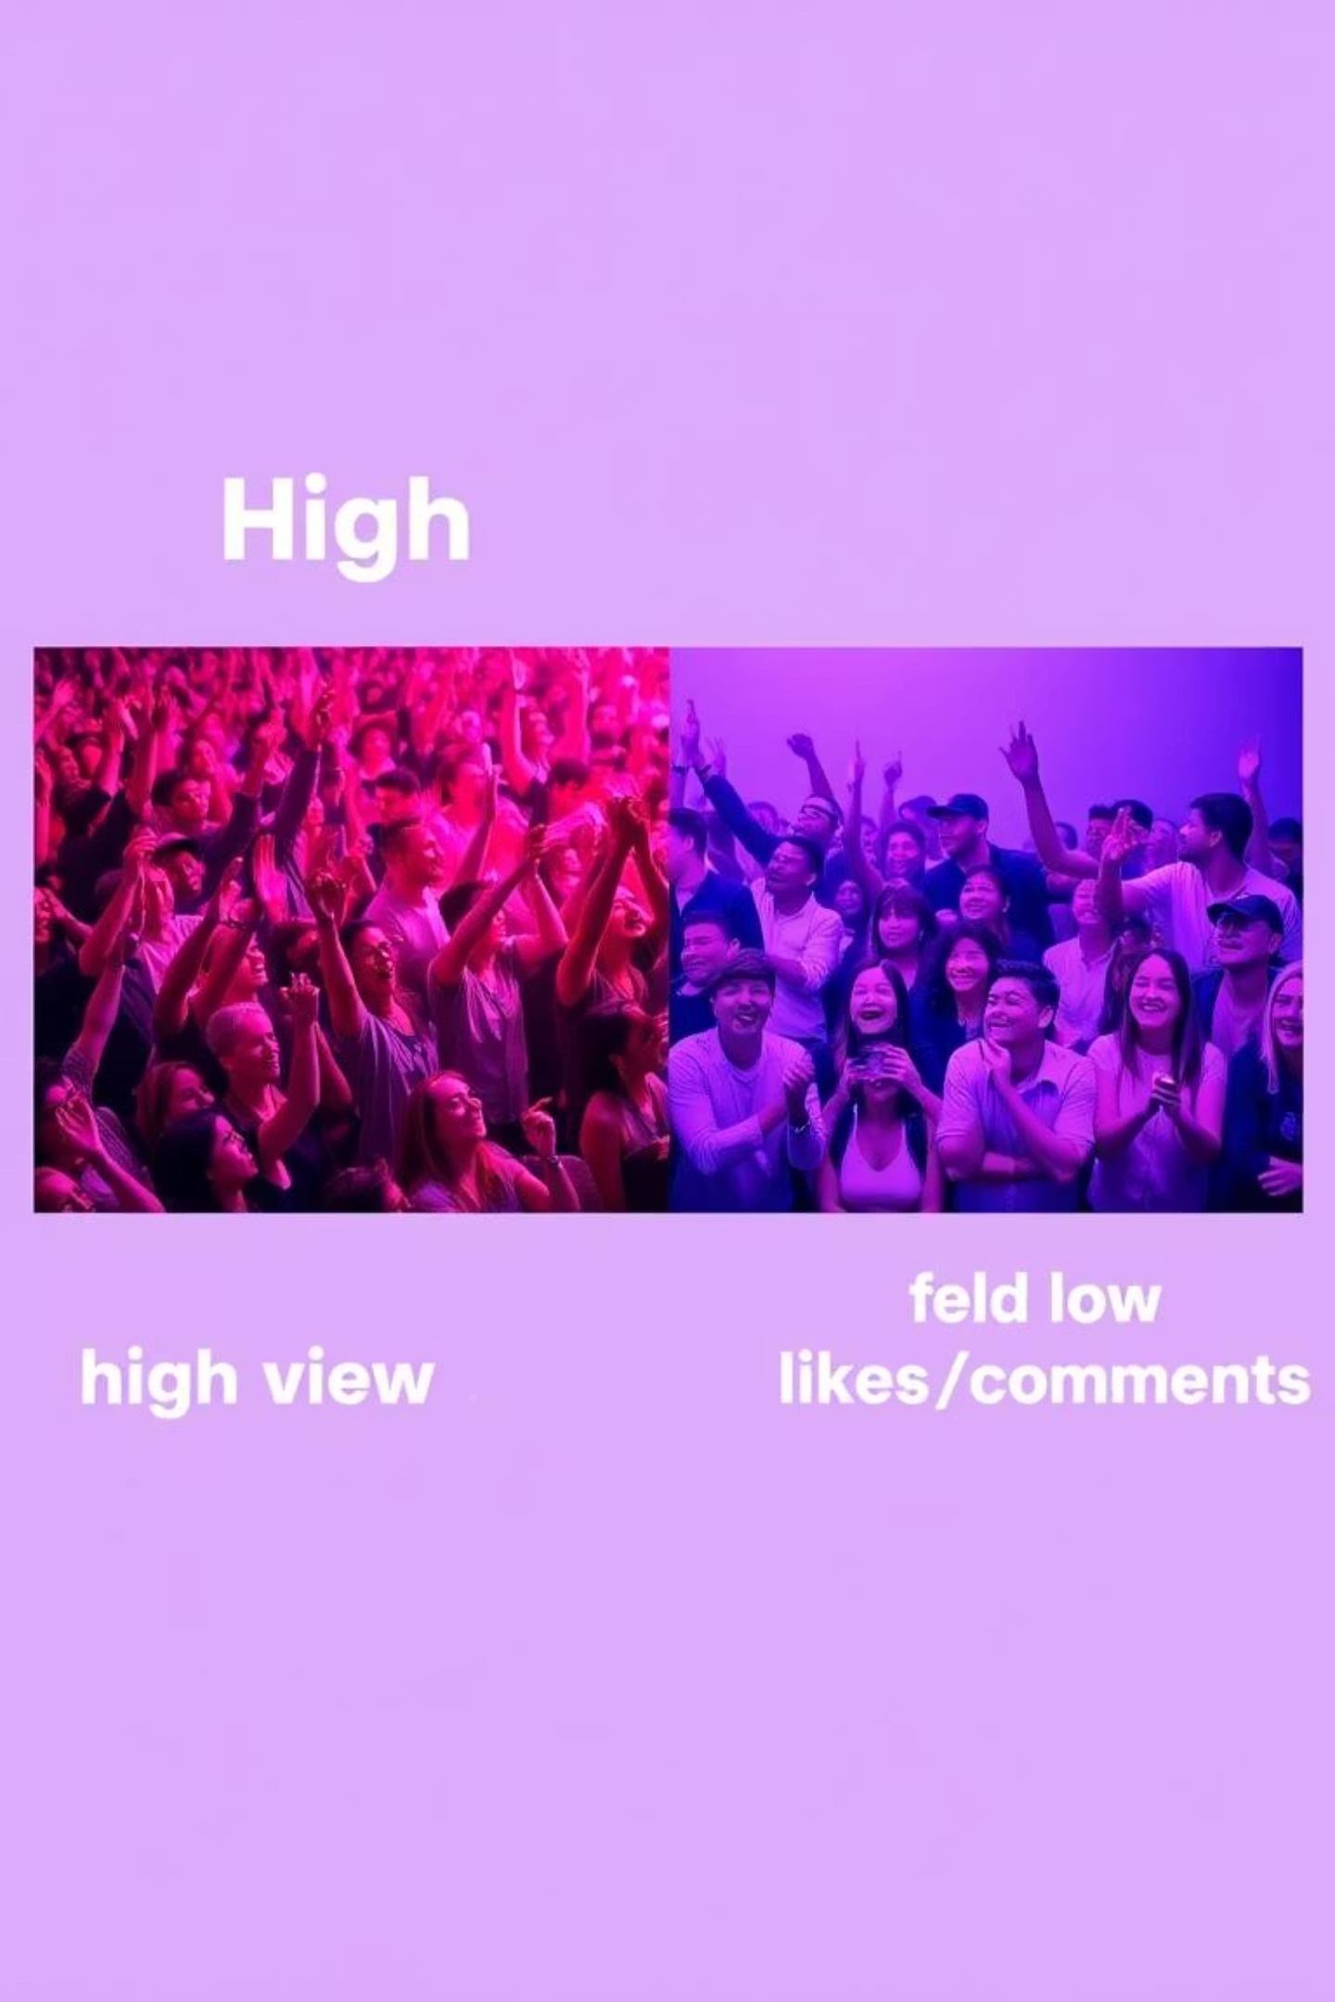
High Views ≠ High Likes
Some videos with millions of views had relatively low engagement (likes/comments).
Possible cause: Clickbait thumbnails or titles?
Story Angle:
"Not all viral videos are loved. A pattern emerged where some of the most-viewed videos had poor like ratios — suggesting viral reach doesn’t always reflect content quality."

Slide 4



Trending Duration vs Views
No clear correlation
Fast Spike
Longer Plateau
Between how long a video trends and its total views.
Some videos trend for 1–2 days but spike in views fast.
Others stay longer but plateau.
Story Angle:
"Going viral fast may not need a long trending period — timing and category seemed more important than staying power."

Slide 5

Title Sentiment & Performance
Sentiment analysis of titles showed that
neutral or slightly positive tones dominate.
Negative or emotionally charged titles
had higher comment counts.
Story Angle:
"Videos with emotionally charged titles, especially negative or controversial ones, drove more discussion — highlighting how emotion affects engagement."

Slide 6
What Can Be Done With This?
Content creators can optimize for trending categories but consider underserved ones for niche engagement.
Brands/marketers should track engagement ratios — not just views — to assess true performance.
YouTube France might promote more diversity by adjusting how content in underrepresented categories is surfaced.
Building a dashboard or predictive model to flag likely-to-trend videos can bring massive business value.
Final Message for Storytelling Slide:
"Trending videos in France tell a story of entertainment dominance, emotional triggers, and rapid spikes in visibility. But beneath the views lie insights about quality, timing, and audience behavior — the real keys to cracking the YouTube algorithm."

